Slide 1




How Klout is changing the landscape of social media with Hadoop and BI
Dave Mariani
VP Engineering, Klout
Denny Lee
Principal Program Manager
Microsoft

Slide 2
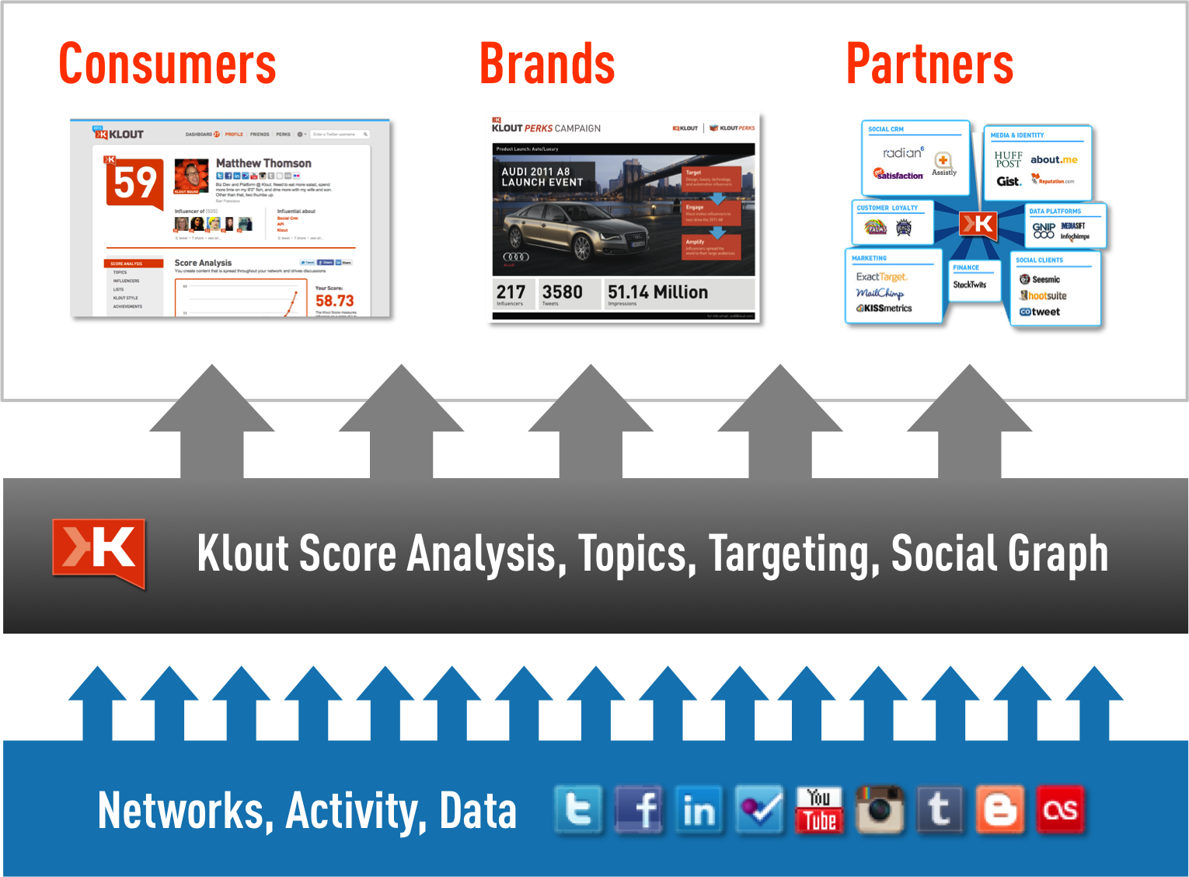
Discover and be recognized for how you influence the world

Slide 3
Klout’s Big Data makes all this possible
15 Social Networks Processed Every Day
120 Terabytes of Data Storage
200,000 Indexed Users Added Every Day
140,000,000 Users Indexed Every Day
1,000,000,000 Social Signals Processed Every Day
30,000,000,000 API Calls Delivered Every Month
54,000,000,000 Rows of Data In Klout Data Warehouse

Slide 4

Klout data Architecture The Best tool for the job
Serving Stores
Registrations DB
(MySql)
Klout.com
(Node.js)
Klout API
(Scala)
Data
Enhancement
Engine
(PIG/Hive)
Data Warehouse
(Hive)
Profile DB
(HBase)
Mobile
(ObjectiveC)
Signal
Collectors
(Java/Scala)
Partner API
(Mashery)
Search Index
(Elastic Search)
Streams
(MongoDB)
Monitoring
(Nagios)
Dashboards
(Tableau)
Analytics
Cubes
(SSAS)
Perks Analyics
(Scala)
Event Tracker
(Scala)

Slide 5
What is Business Intelligence?
Data Warehousing, OLAP, Dashboards, Reporting
Ability to slice and dice data in an ad-hoc manner
Getting the right data to the right people, at the right time
i.e. Now

Slide 6
Why Hadoop + BI?
Requirement | Hadoop & Hive | BI Query Engines
Capture & store all data | Yes | No
Support queries against detail data | Yes | No
Support interactive queries & applications | No | Yes
Support BI & visualization tools | No | Yes

Slide 7
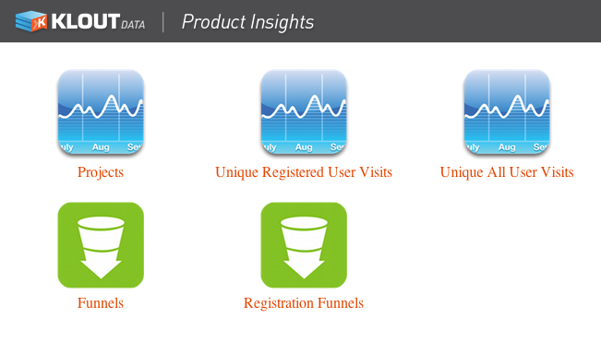
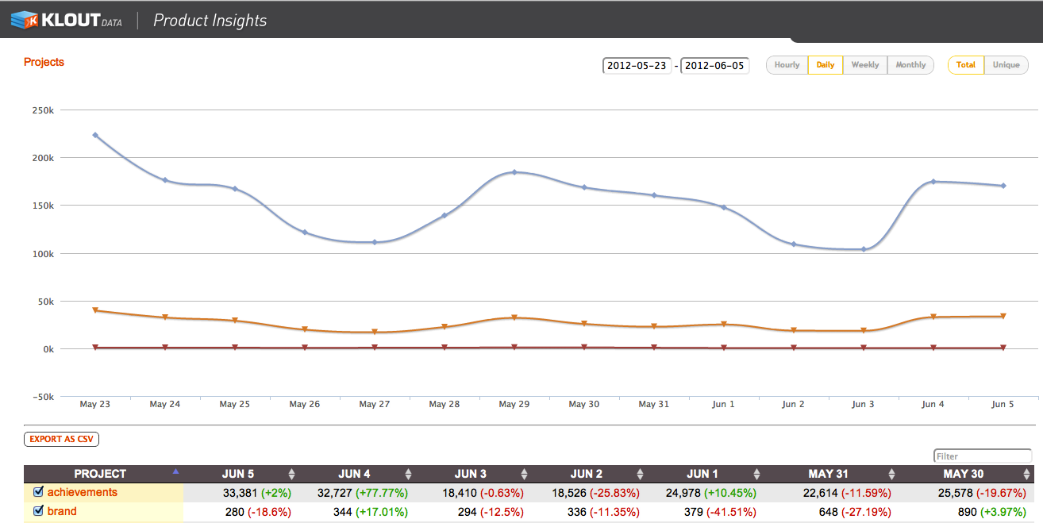
An Example: Klout Event Tracker
1
Perform A|B Testing of User Flows
2
Optimize Registration Funnels
3
Monitor consumer engagement & retention (DAUs & MAUs)
4
Flexibly track and report on user generated events

Slide 8
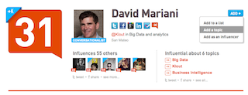
A Flexible, Hierarchical Schema
Project:
Collection
of Events
Event:
Captured
User Action
Property Type:
Attribute
Key
Property Value:
Attribute
Value
HomePage,
Actions,
Mobile iOS
Source,
Gender,
Location
Google Search
Male
SF
+K (Add a topic) event

Slide 9


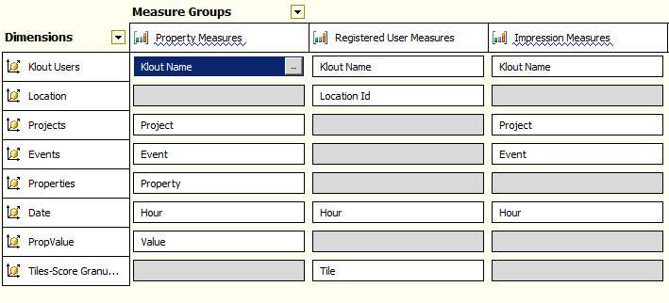


Event Tracker Architecture
event_log
tstamp string
project string
event string
session_id bigint
ks_uid bigint
ip string
json_keys array<string>
json_values array<string>
json_text string
dt string
hr string
{
"project":"plusK",
"event":"spend",
"session_id":"0",
"ip":"50.68.47.158",
"kloutId":“123456",
“cookie_id":”123456",
"ref":"http://klout.com/",
"type":"add_topic",
"time":"1338366015"
}
will be saved in HDFS at:
/logs/events_tracking/2012-05-30/0100
insights3:9003/track/{"project":”plusK","event":”spend”,
"ks_uid":123456,”type":”add_topic"}
Warehouse
Tracker API
Scala,
node.JS
Log Process
Flume
Cube
Analysis Services
Klout UI
Scala,
AJAX UX
SELECT { [Measures].[Counter], [Measures].[PreviousPeriodCounter]}
ON COLUMNS,
NON EMPTY CROSSJOIN (
exists([Date].[Date].[Date].allmembers,
[Date].[Date].&[2012-05-19T00:00:00]:[Date].[Date].&[2012-06-02T00:00:00]),
[Events].[Event].[Event].allmembers ) DIMENSION PROPERTIES MEMBER_CAPTION
ON ROWS
FROM [ProductInsight]
WHERE ({[Projects].[Project].[plusK]})
Instrument
Collect
Persist
Query
Report

Slide 10
Hadoop & BI Together: Query Cube using a Custom App

Slide 11
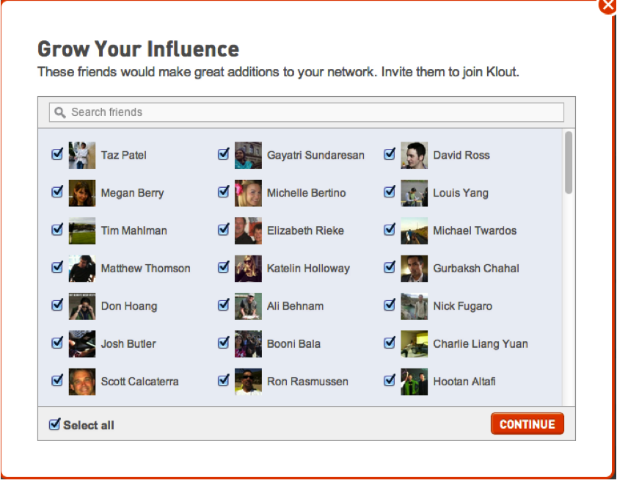
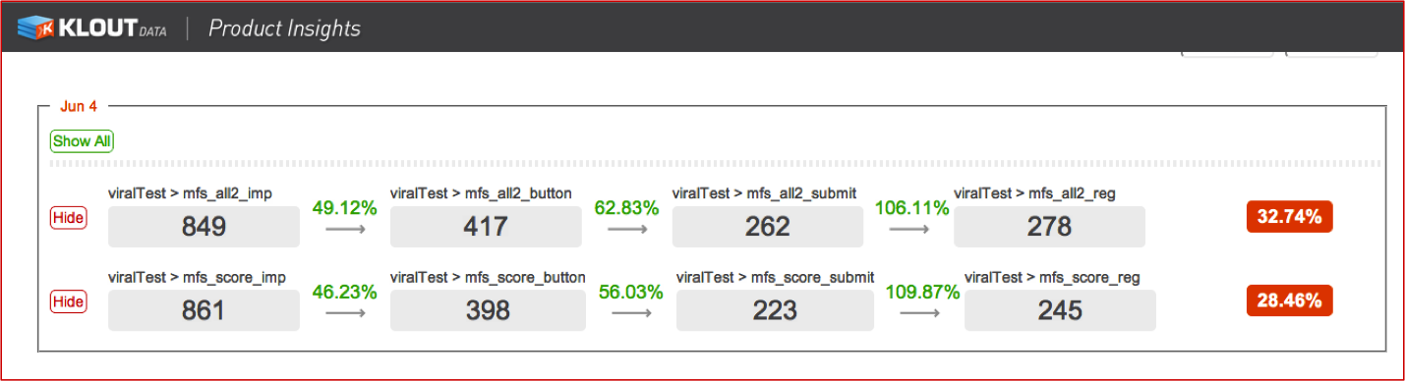
A peek into product insight > A|B test : unsorted vs. Sorted

Slide 12
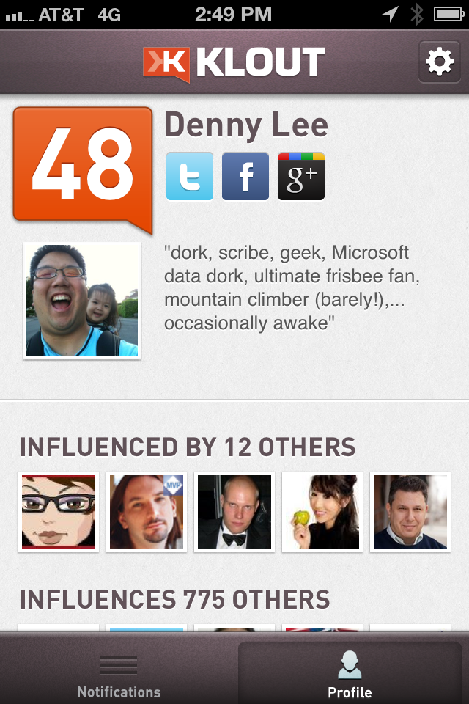
A Peek into Product Insights > Projects: Mobile iOS

Slide 13
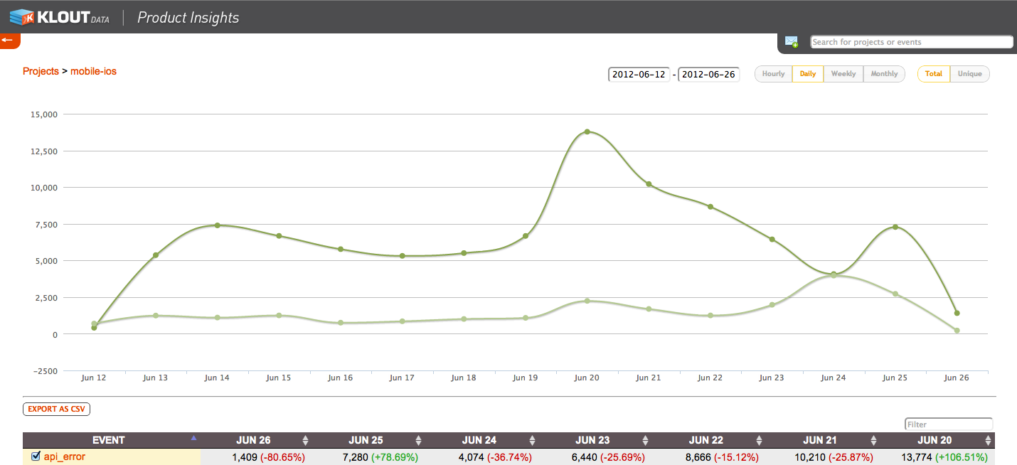

Slide 14

Hadoop & BI Together: Query Cube Using Viz App

Slide 15
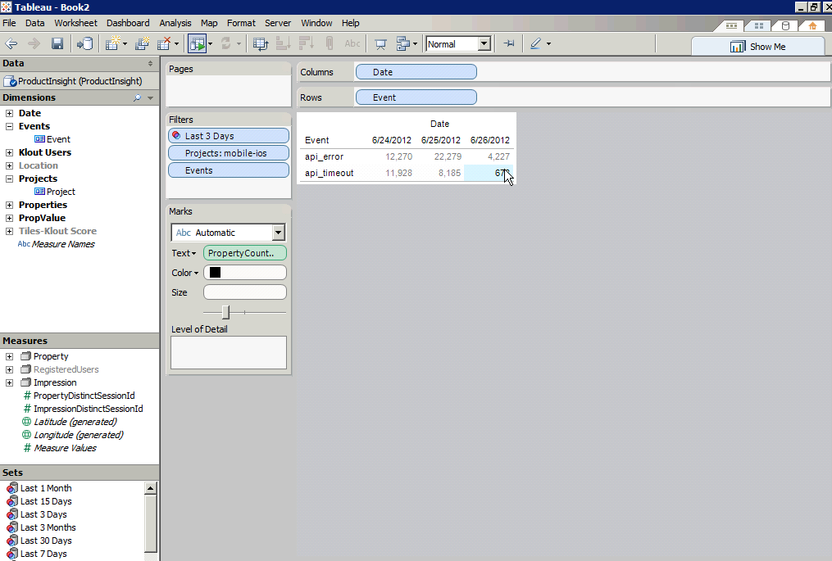
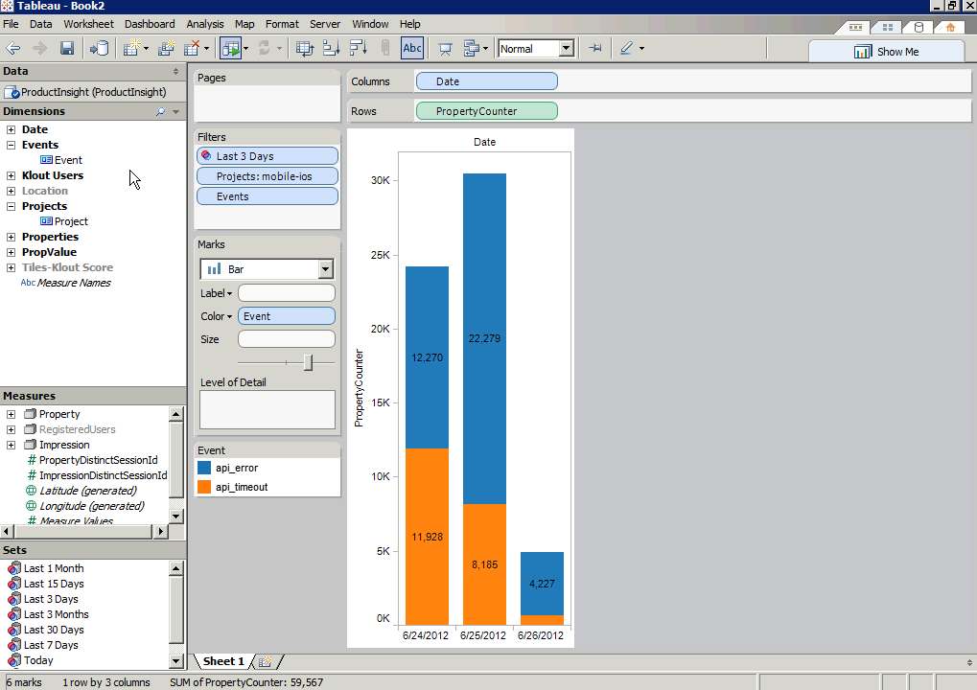

Slide 16
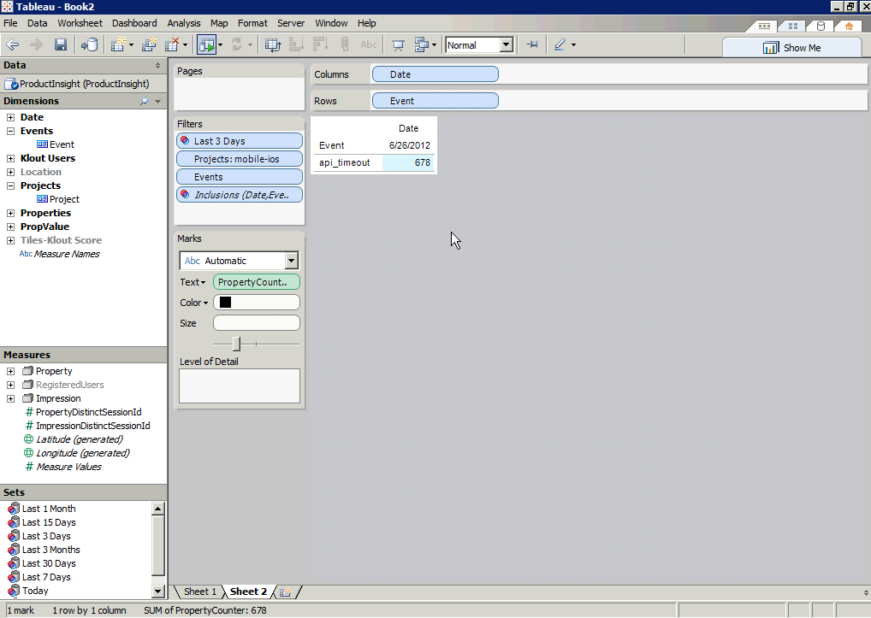
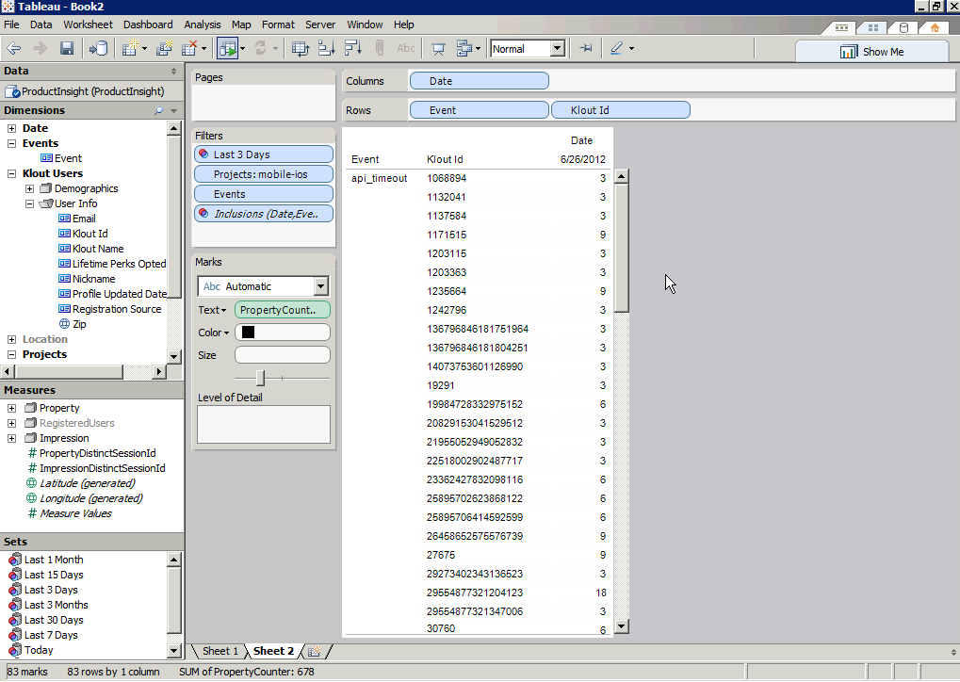

Slide 17
Hadoop & BI Together: Query Hive using CLI

Slide 18
HiveQL Example
SELECT
get_json_object(json_text,'$.sid') as sid,
get_json_object(json_text,'$.inc') as inc,
get_json_object(json_text,'$.status') as status,
event
FROM bi.event_log
WHERE project='mobile-ios'
AND dt=20120612
AND get_json_object(json_text,'$.v')<>'1.5'
AND (event = 'api_error' OR event = 'api_timeout')
ORDER BY sid;
Notes:
Copy this from notepad for demo:
CREATE TABLE mobile_ios_details_20120612 as
SELECT
get_json_object(json_text,'$.sid') as sid,
get_json_object(json_text,'$.inc') as inc,
get_json_object(json_text,'$.status') as status,
event
FROM bi.event_log
WHERE project='mobile-ios'
AND dt=20120612
AND get_json_object(json_text,'$.v')<>'1.5'
AND (event = 'api_error' OR event = 'api_timeout')
ORDER BY sid;

Slide 19
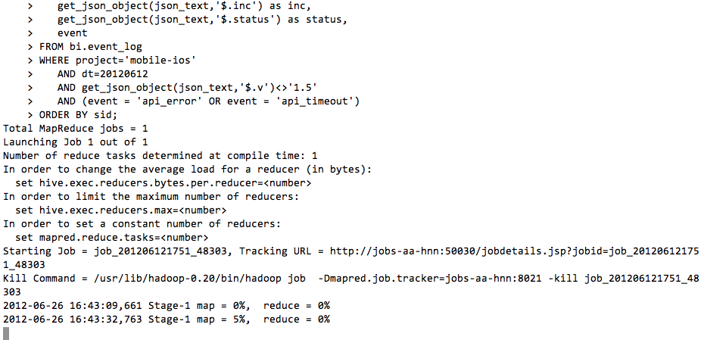
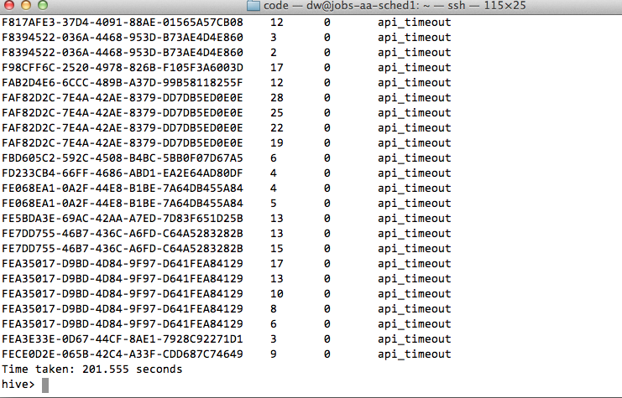

Slide 20

Hadoop & BI Together: Query Hive using Excel

Slide 21
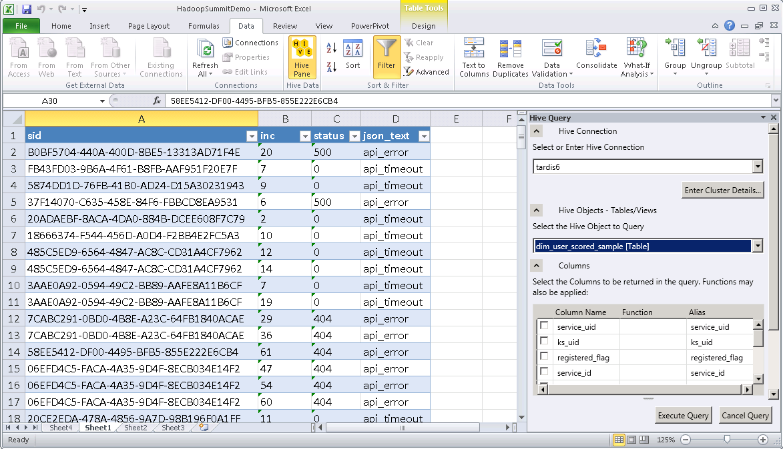
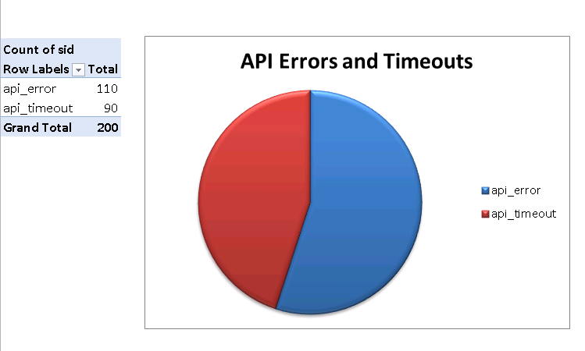

Slide 22
Why Hadoop + BI?
Requirement | Hadoop & Hive | BI Query Engines
Capture & store all data | Yes | No
Support queries against detail data | Yes | No
Support interactive queries & applications | No | Yes
Support BI & visualization tools | No | Yes
Notes:
1. Don’t throw data away, leverage Hadoop (track users and events for a/b testing)
2. BI tools aggregate data, but we need to reach back to the detail to answer deeper questions (http codes)
3. Hadoop != interactive queries (combined proprietary data with detail)
4. Use open source, but don’t reinvent the wheel (BI tools are mature, valuable & complementary)
Leverage the best tool for the function or job

Slide 23
Any Questions?

